Slide 1
Identification of Salt Regions in Seismic Images using Deep Learning
Course - Machine learning (CS -584)
Instructor: Dr. Yan Yan
Team members (Group 31):
Naveen Raju Sreerama Raju Govinda Raju (A20516868)
Sai Manohar Vemuri (A20514848)
Sesha Shai Datta Kolli (A20516330)

Slide 2
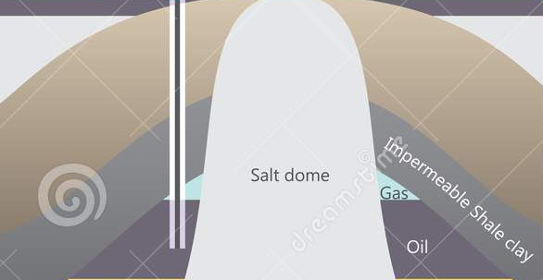
Motivation and Problem Statement
Many companies Extracting oil and gas reserves, several places of the Earth that are rich in oil and natural gas
Finding subsurface salt deposits using Seismic waves
Knowing precise locations of large
salt deposits is extremely important
to companies involved in oil and gas
exploration.

Slide 3
Large amounts of salt are present beneath the surface of many oceans and seas around the world. Seismic images have historically been used to locate salt deposits underground.
Misinterpretation of the salt boundaries typically results in higher expenses.
Seismic image interpretation by humans can be difficult at times and is not always accurate.
Salt density is usually about 2.14 g/cm³, which is less than most nearby rocks. Salt seismic velocity of around 4.5 km/s is usually bigger than the surrounding rocks

Slide 4
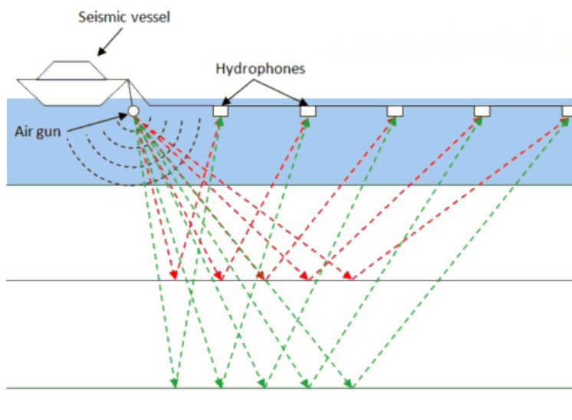
Seismic imagery
Technology called seismic imagery is used to describe the subsurface geology.
It is based on the emission of sound waves into the ocean, where they are reflected off of underwater object structures and detected on the surface by hydrophone receivers.
Seismic imaging enables the 3D visualization of underground structures

Slide 5
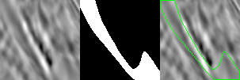
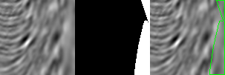
Salt regions in Seismic images

Slide 6
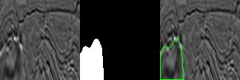
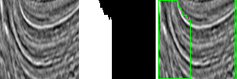
Salt regions in Seismic images

Slide 7
Dataset
Training dataset images and groudtruth masks - 1151
Testing dataset images and groudtruth masks - 302

Slide 8
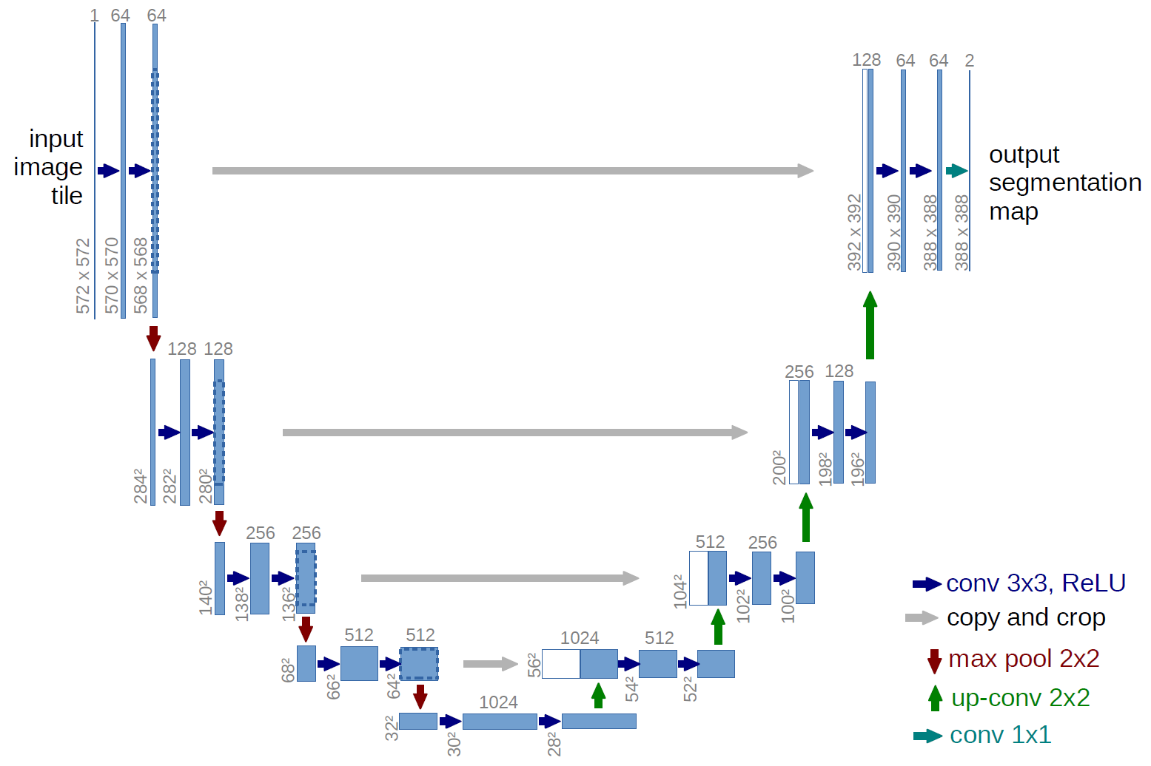
U-Net Architecture
Semantic Segmentation
Contracting Path and Expansive Path
Skip Connection by Concatenation
During encoding Spatial information is reduced while feature information is improved
Expansive path combines spatial information from contractive path and features learned
Augmentation is needed

Slide 9
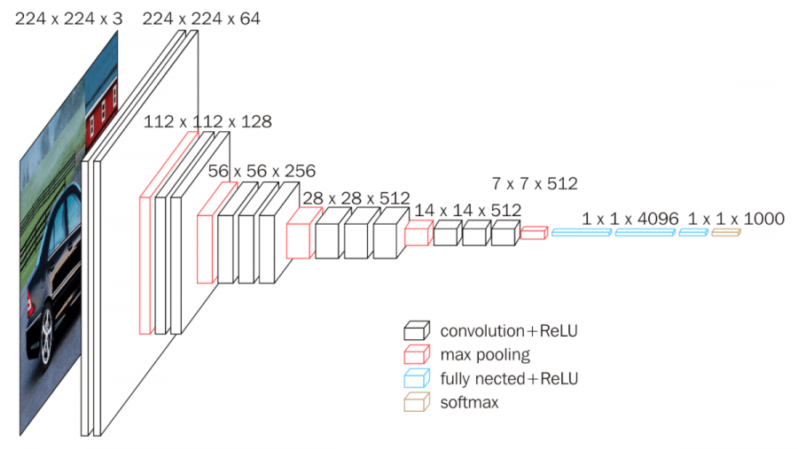
VGG 16 as Backbone
Used for Object detection and classification
16 Layers
Smaller kernel size: 3x3
Used to replace encoder part of the U-Net
Degrades performance if we implement deep networks

Slide 10
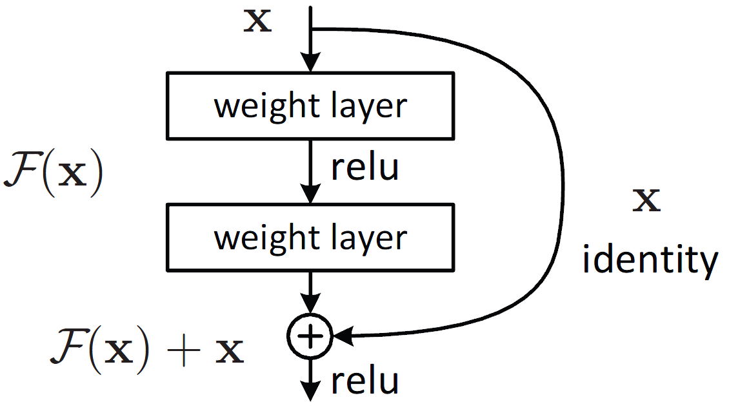
Resnet as Backbone
Using residual blocks allows to train much deeper networks.
Allows for the input x and F(x) to be combined as input to the next layer
Uses skip connections f(x)+x
Can tackle exploding and vanishing gradient problem using identity mapping

Slide 11
Custom U-net model with Residual Block
Used Residual block
Encoder and decoder path will have 5 CNN blocks each
Each block consists of 4 Convolutional layers
Activation function: Relu & Sigmoid
Optimizer: Adam
Metric: IOU Score

Slide 12
Training procedure
Initial learning rate =0.01
Reduce learning rate on plateau with patience rate of 4 and factor of 0.1, based on validation loss
Adam, ADA Grad optimiser
Augmentation: Vertical flip, Horizontal flip, width_shift, height_shift, shear, zoom, rotation,
Contrast limited adaptive histogram equilisation, image sharpening, gamma correction(Power Law Transform)
Epochs = 100, 200
Batch size = 6
Metrics used: IOU score
Loss function: Binary cross entropy, Focal loss+Dice loss

Slide 13
Evaluation metrics
 | AVERAGE IOU | F1 SCORE | ACCURACY | PRECISION | RECALL | BINARY THREHOLD | PARAMETERS
VGG 16 | 75.760 | 0.8366 | 0.923 | 0.856 | 0.855 | 95 | 23,751,121
RESNET 50 | 75.760 | 0.8366 | 0.923 | 0.856 | 0.855 | 95 | 32,554,836
RESNET 50 (Robust augumentation) | 78.895 | 0.849 | 0.938 | 0.8570 | 0.879 | 85 | 32,554,836
RESNET 101 | 79.119 | 0.848 | 0.935 | 0.866 | 0.880 | 110 | 51,599,188
RESNET 101 (Robust augumentation) | 79.174 | 0.851 | 0.939 | 0.868 | 0.874 | 90 | 51,599,188
RESNET 101 (Robust augumentation) ADAGRAD | 77.508 | 0.837 | 0.930 | 0.845 | 0.871 | 105 | 51,599,188
CUSTOM MODEL | 84.168 | 0.888 | 0.951 | 0.901 | 0.903 | 25 | 4,141,833

Slide 14
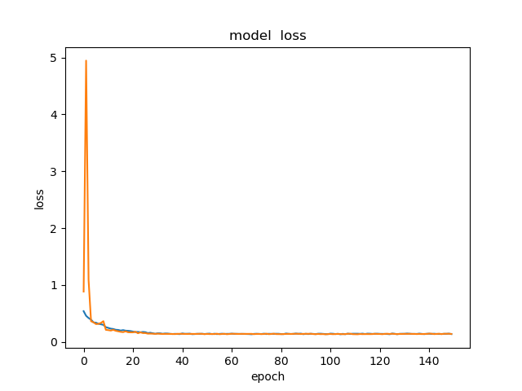
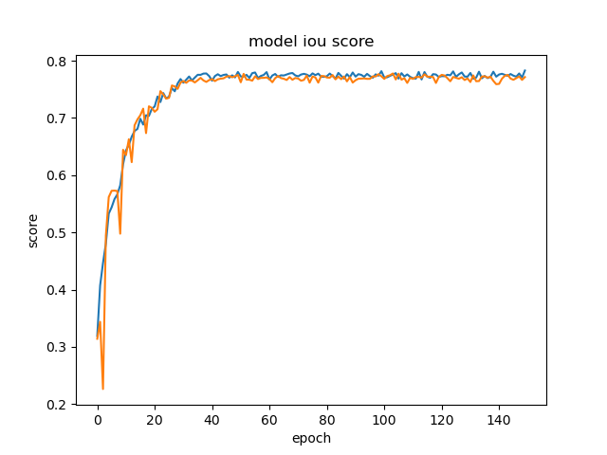
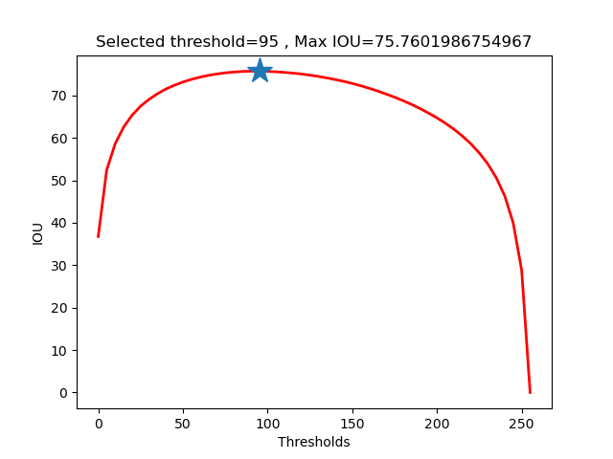
VGG 16
loss: 0.1367 - iou_score: 0.7828 - val_loss: 0.1392 - val_iou_score: 0.7714
loss function Binary Cross entropy

Slide 15
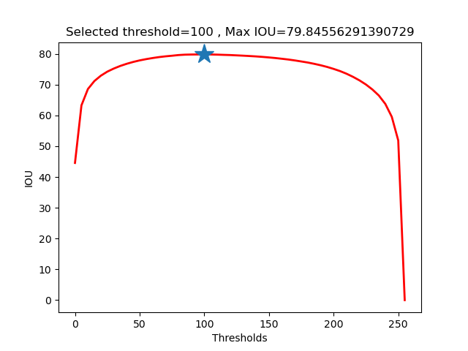
RESNET 50
loss: 0.1367 - iou_score: 0.7828 - val_loss: 0.1392 - val_iou_score: 0.7714
loss function Binary Cross entropy

Slide 16
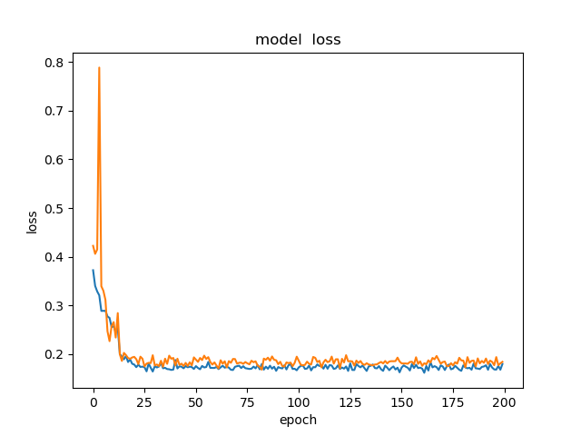
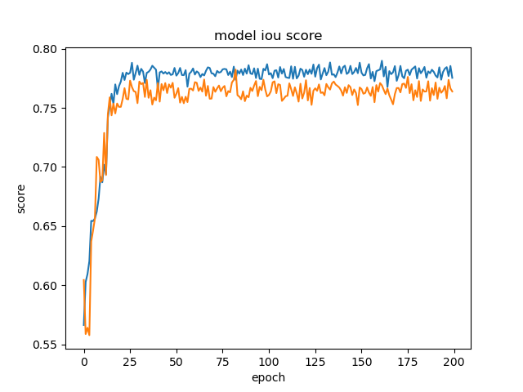
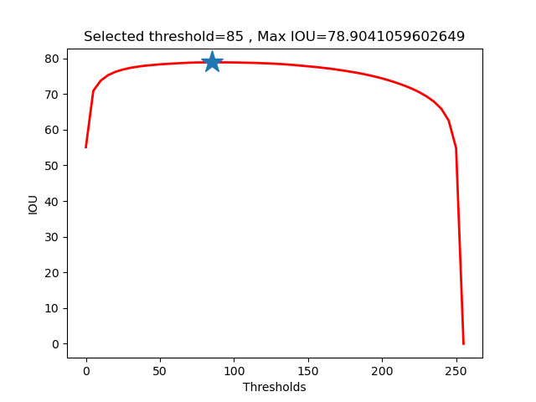
RESNET 50 (Robust Augmentation)
loss: 0.1367 - iou_score: 0.7828 - val_loss: 0.1392 - val_iou_score: 0.7714
loss: 0.1793 - iou_score: 0.775 - val_loss: 0.183 - val_iou_score: 0.763
loss function focal loss + Dice loss

Slide 17
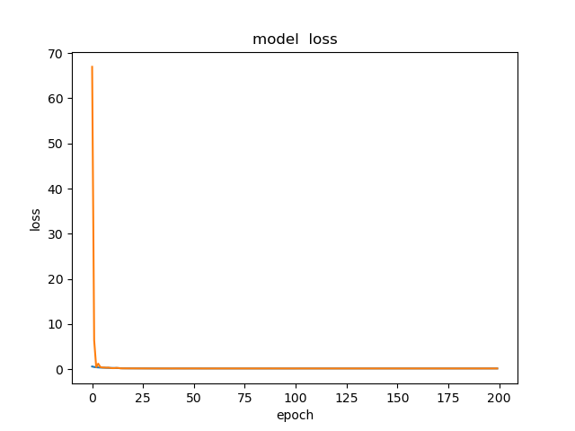
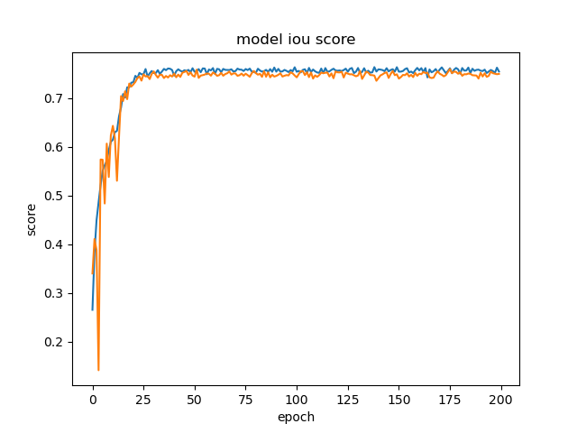
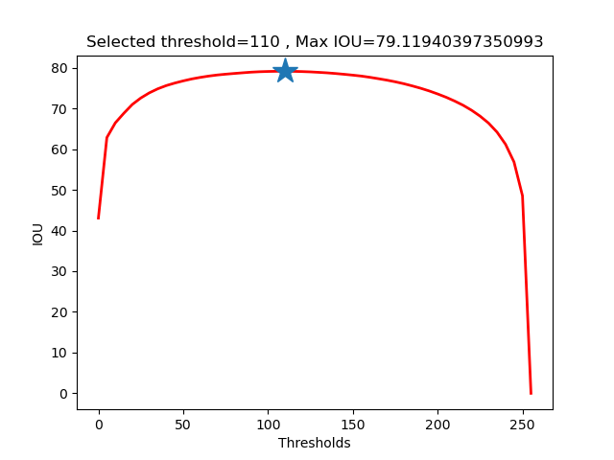
RESNET 101
loss: 0.1567 - iou_score: 0.7551 - val_loss: 0.1541 - val_iou_score: 0.7502
loss function focal loss + Dice loss

Slide 18
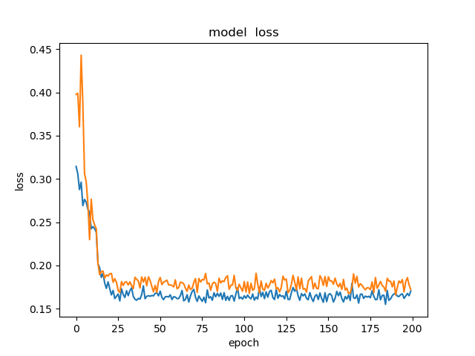
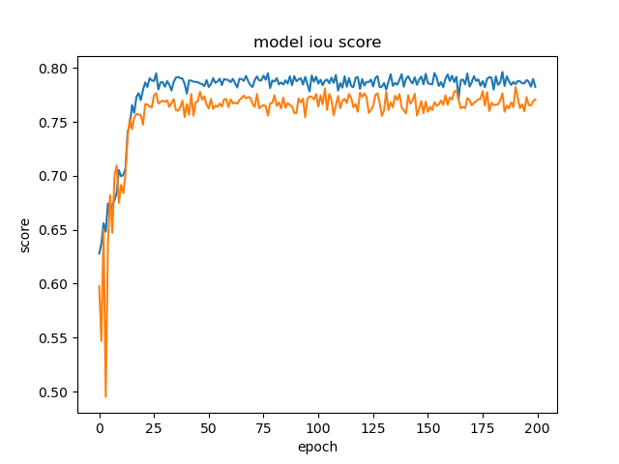
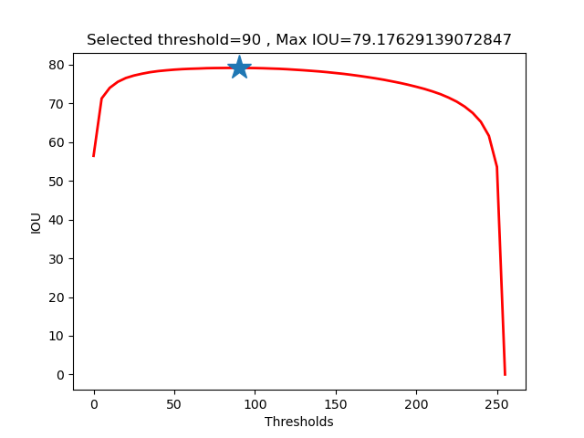
RESNET 101 (Robust Augmentation)
loss: 0.170 - iou_score: 0.782 - val_loss:0.172 - val_iou_score:0.770
loss function focal loss + Dice loss

Slide 19
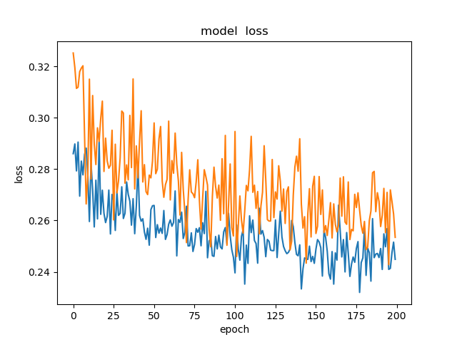
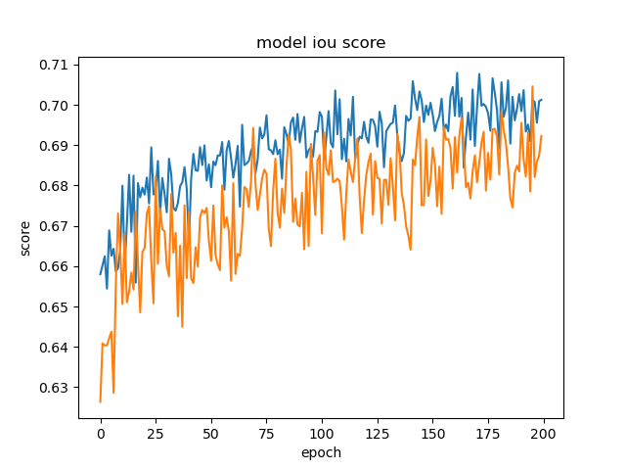
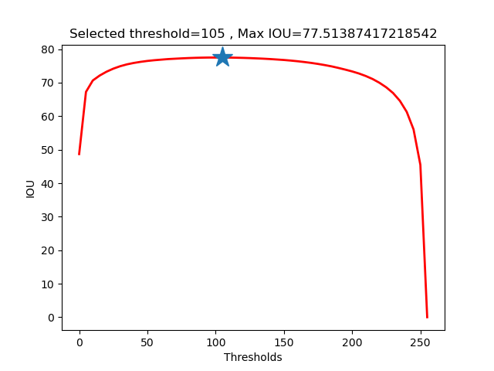
RESNET 101 (ADA Grad)(Robust Augmentation)
loss: 0.2449 - iou_score: 0.7012 - val_loss: 0.2534 - val_iou_score: 0.6923
loss function focal loss + Dice loss

Slide 20
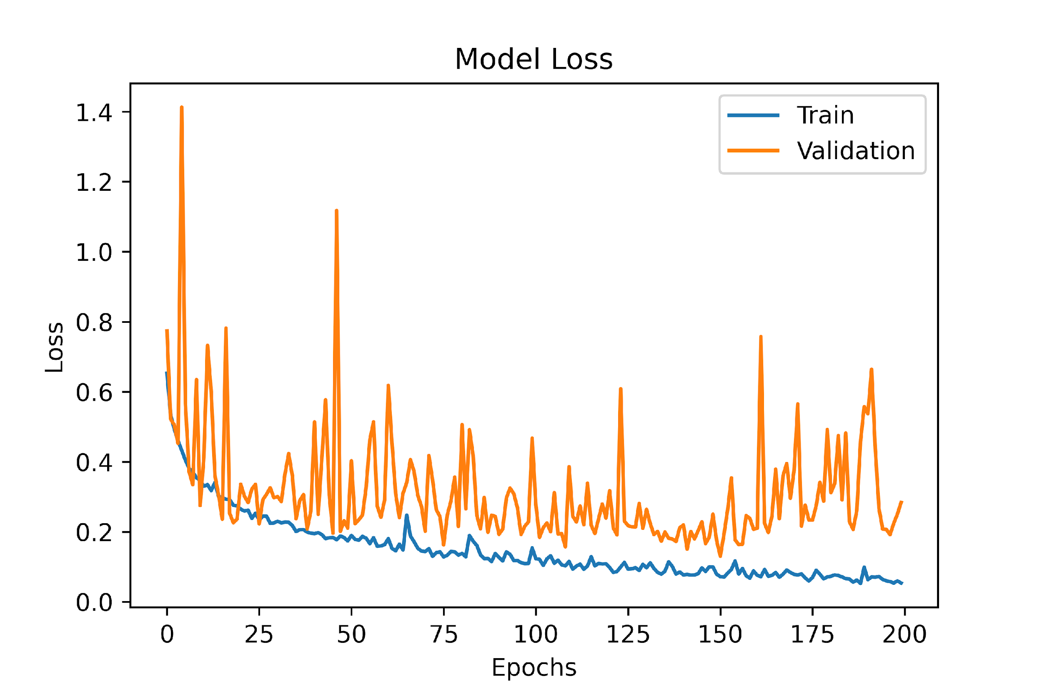
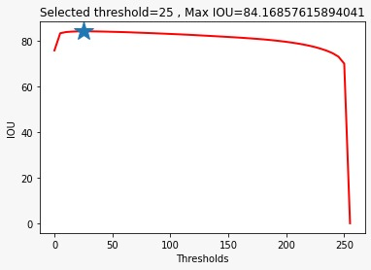
CUSTOM MODEL
loss function focal loss + Dice loss

Slide 21
LOSS FUNCTION
Binary Cross Entropy
CE = -log(p)*y - log(1-p)(1-y)
where,
p is the predicted probability, y is the ground truth
When y=1,
p=0.9 CE= 0.045
P=0.1 CE=1

Slide 22
Balanced Binary Cross Entropy
Positive samples - 100
Negative samples - 80
Class weight for positive sample = 0.8
Class weight for negative sample = 1
CE = -0.8*log(p)*y - 1*log(1-p)(1-y)
When y=1,
p = 0.9 CE = 0.0366
p = 0.1 CE = 0.8

Slide 23
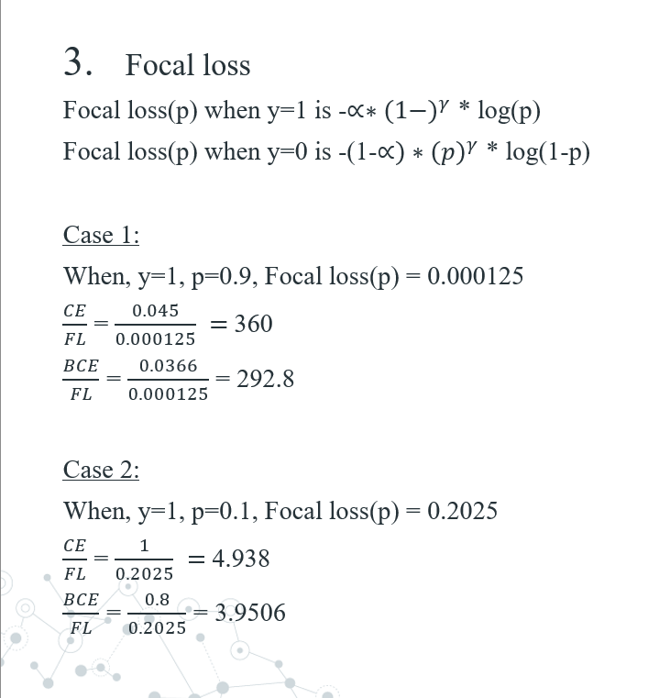

Slide 24
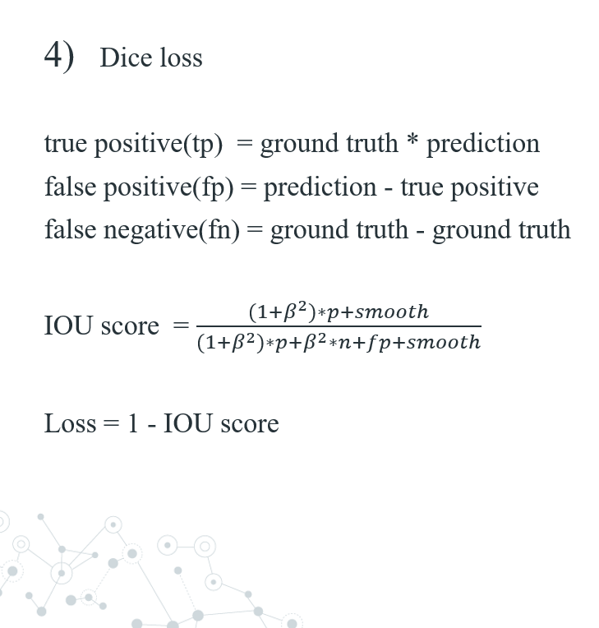

Slide 25
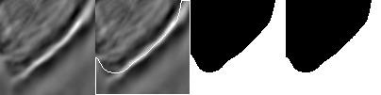
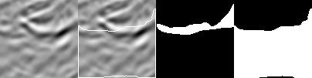
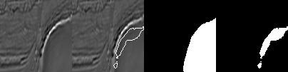
Results
True Positive
False Positive
False Negative

Slide 26
Contribution
Naveen Raju Sreerama Raju Govinda Raju
- Image processing augmentation exploration
- UNet architecture with different backbones coding
- Training and testing
Sai Manohar Vemuri
Unet Architecture research
Custom architecture design and exploration
Training and testing
Sesha Shai Datta Kolli
- Data set exploration and domain knowledge research
- Data set cleaning
- Analysis of predictions

Slide 27
Any Questions

Slide 28
Thank you

